Slide 1
Apollo: Autonomous Parking (Motion Planning and Control)
Amith Ramdas Achari, Peng Han, Yuehui Yu, Xiaoxu Sun
amithr3, penghan2, yuehuiy2, xiaoxus2

Slide 2
Problem Statement
The problem is to plan and follow a trajectory from point A to point B avoiding obstacles with smaller errors.
Planning: Determine the trajectory that GEM has to follow, this is done using sampling based planning, namely RRT*
Control: Control the vehicle to track the trajectory resulted from planning using a PID controller.
Motivation:
Motion Planning is a difficult problem
Planning technique can be used for different use cases. RRT* is one of state of the art techniques used in the autonomous driving sector

Slide 3

Problem Faced
Find the shortest path between two points using Astar algorithm
Apply to a real car
Oops!

Slide 4
Claim
Sampling based technique RRT* is used to generate waypoints that obey the non-holonomic constraints of the vehicle
Dubins RRT* is used to solve the problem of constraints
The vehicle is successfully controlled to follow a second order polynomial generated by our planning algorithm's waypoints.

Slide 5
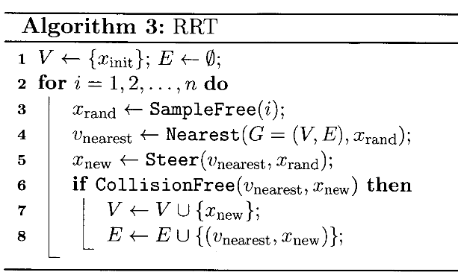
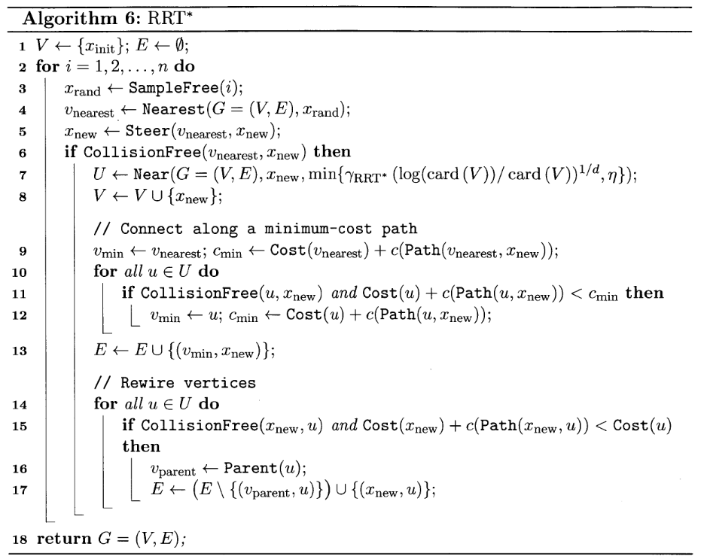
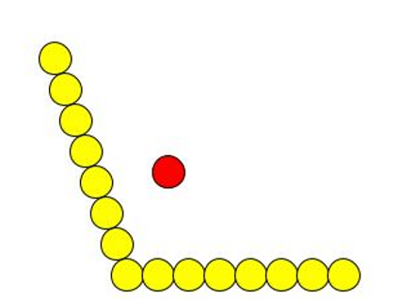
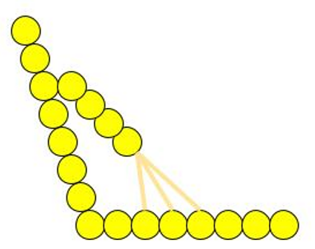
RRT vs RRT*
Rewire Step

Slide 6
Results
Important results to learn:
Multiple tests simulated to find the tuning parameter of RRT*
Bias - It either explores or exploits knowing the goal position. By increasing the likelihood of sampling states from a specific area, RRT* growth can be biased.
Step Radius - The radius within which nodes look for new neighbors to connect with.

Slide 7
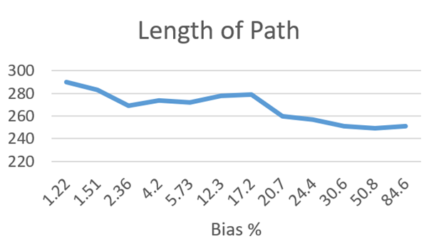
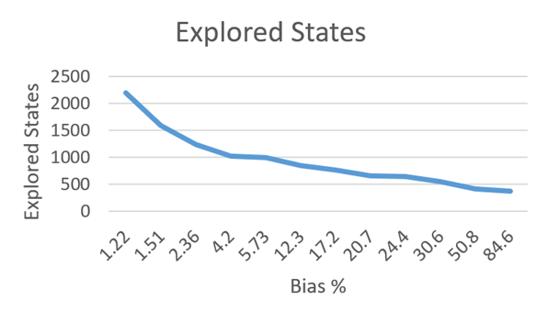
Hyperparameter: Bias
Bias
Problem with High Bias: Cannot be used in blocked environments.
Notes:
The metrics explored states and length of path are the two things we wanted to look out for by varying the hyperparameters bias and step radius.

Slide 8
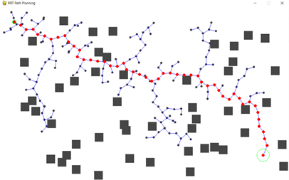
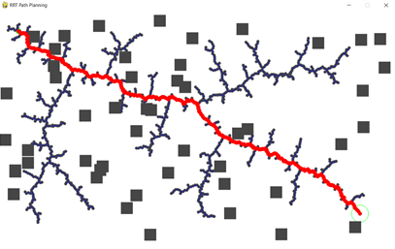
Hyperparameter: Step Radius
Left: Step Radius = 25px (3.03ms), Right: Step Radius = 5px (3.35ms)
Notes:
The radius of the step is another parameter that was varied, and the results were collected. It is seen that with a larger step
radius, the goal was reached faster, but the path generated was not smooth at all. As a result, the step radius was reduced in
order to achieve a smoother path with more accurate representation of the way points. At a radius of 5 pixels, the
compromise between accuracy and time for the state to reach its goal was found. The time taken for 5px and 25px was 3.35ms
and 3.03ms, respectively, for a 6 percent bias.

Slide 9
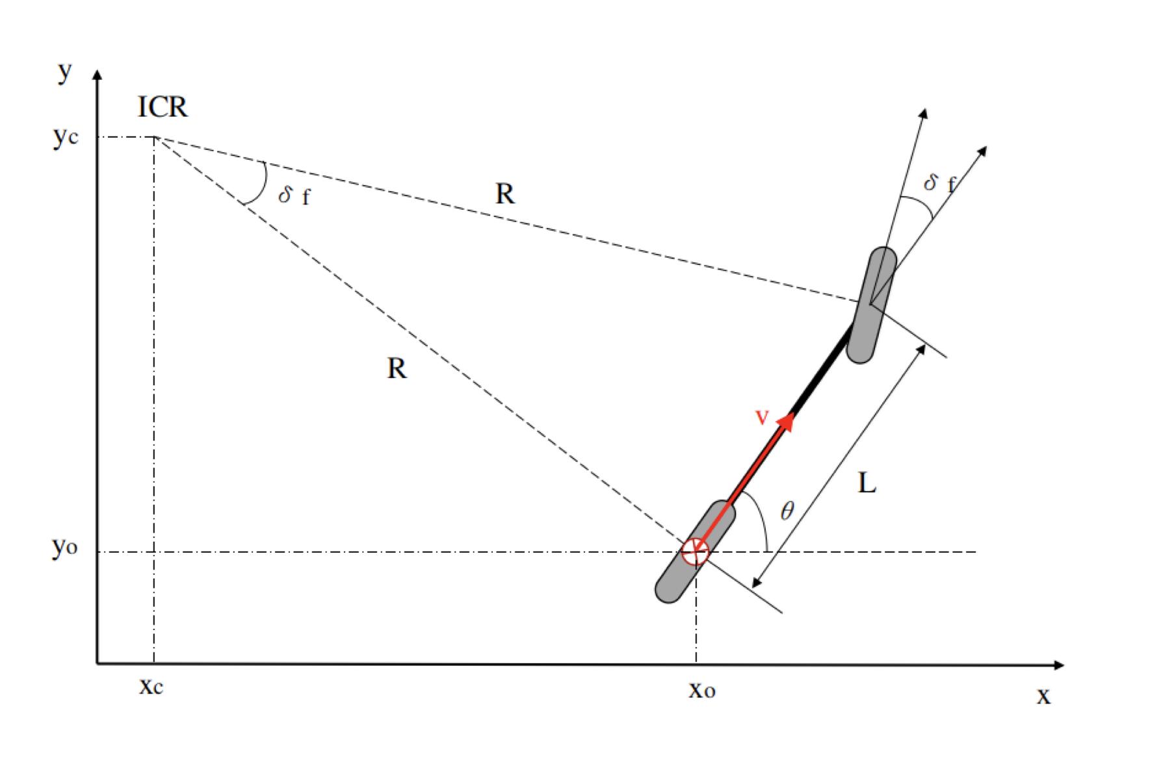
RRT-star algorithm with Dubins path
Vehicle model and Dubins path
L = 1.75 m
δ_{f} = 35 deg
Minimum Radius = R
= L / tan(δ_{f})
= 2.7 m
Curvature = 1 / R
= 1 / 2.7
Notes:
Okay, Let’s talk about vehicle model and dubins path.
Here, we use the bicycle model. The distance between two wheels is denoted by L. And the steering angle of the front wheel is denoted by d_f
From the GEM manual, we can get L = … d_f = … So we can calculate the R

Slide 10
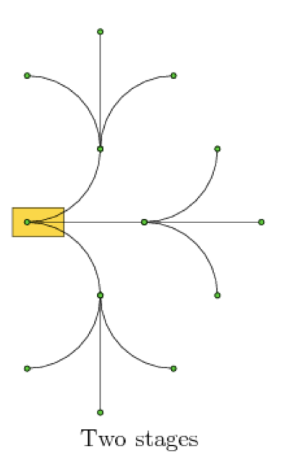
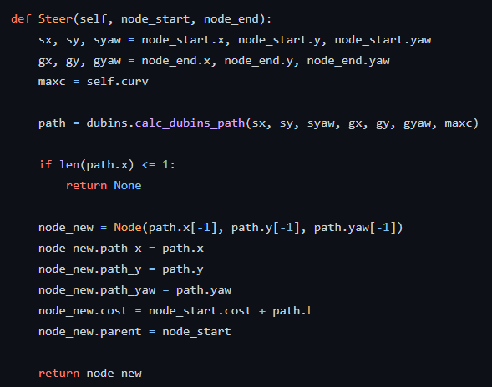
RRT-star algorithm with Dubins path
Vehicle model and Dubins path
Notes:
Okay, Let’s go through the steer function in RRT*. As we learned in the lec, steer function in RRT is used to check if a sampling node can be
Reached from the nearest node. Here, we use Dubins path to realize the function.
Dubins path refers to the shortest curve that connects two points in a 2D plane with a constraint on the curvature.
Three directions. Help check if nodes can be reached

Slide 11
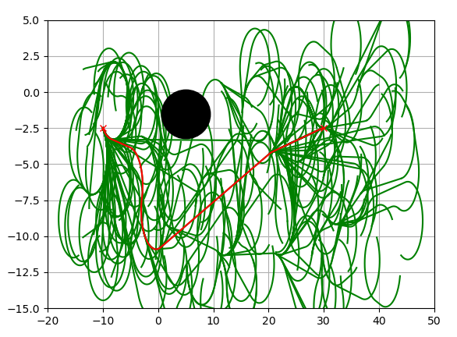
Dubins RRT* algorithm
Generate smooth Trajectory
Asymptotic optimality
Input: Start, Goal, Map
Output: Waypoints (x,y, heading)
Problem: Doesn’t guarantee completeness
Start End

Slide 12
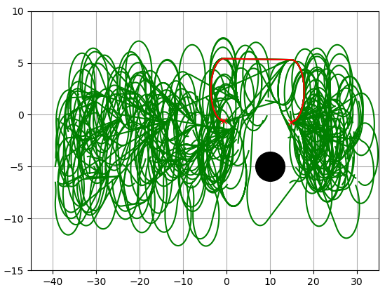
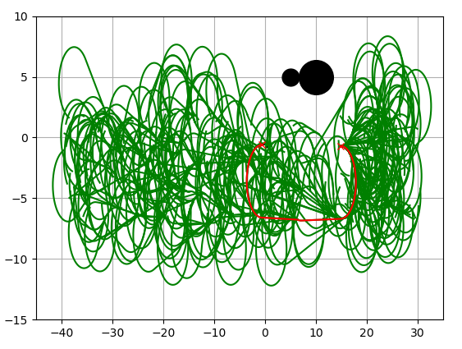
Path generated with obstacles
Start End

Slide 13
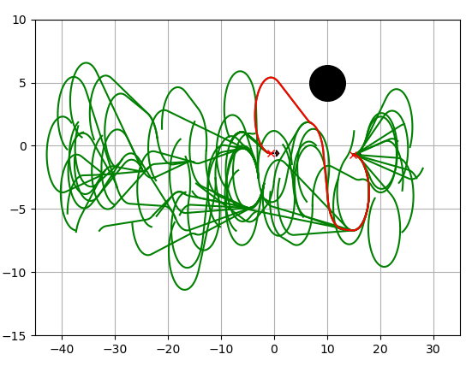
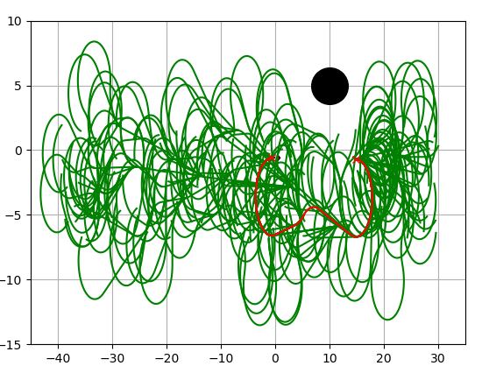
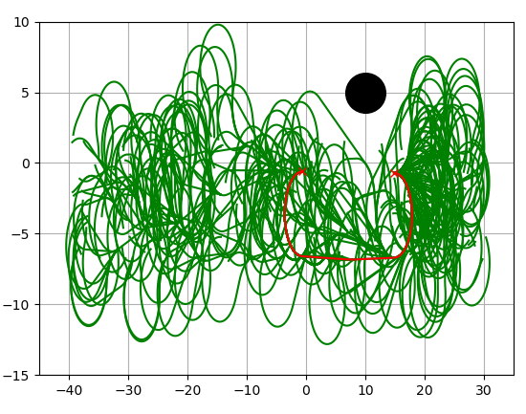
Path for different Nodes
Figure 10. Left: 100 nodes, Middle: 300 nodes, Right: 500 nodes
With increase the number of nodes the path length decreased.
Start End
Notes:
As we learned in class the algorithm is able to generate optimal path as the number of nodes are increased and hence proving asymptotic optimality for RRT* algorithm

Slide 14
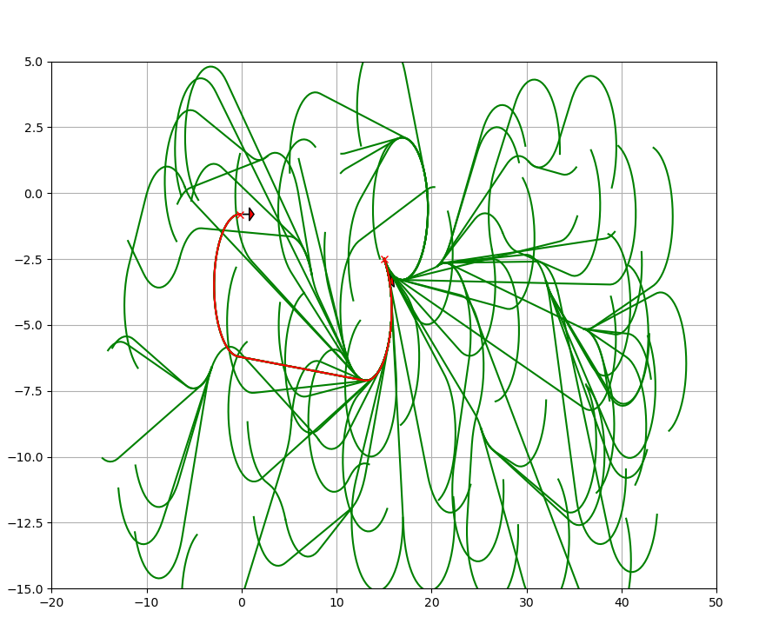
Video of Dubins RRT* in Action
Start End
Notes:
start = [15.0, -2.50, np.deg2rad(-45.0)]
goal = [-0.2, -0.8, np.deg2rad(0.0)]

Slide 15
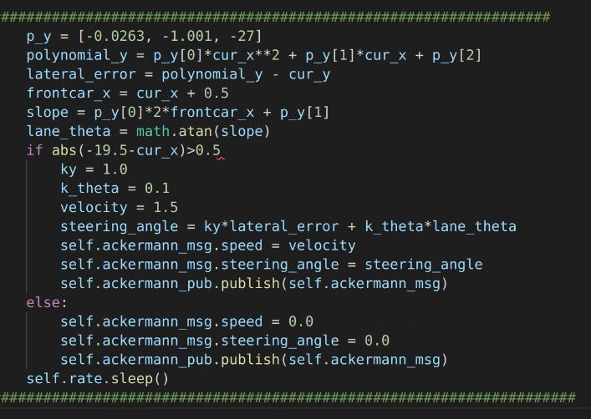
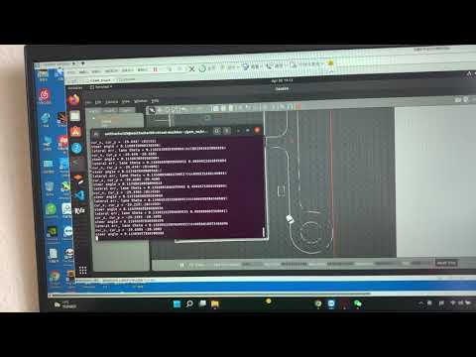
A-star algorithm with a polynomial
Code and simulation
Notes:
Okay, for the second solution, we transform ….
Here is the snippets of our code.
We set poly y, Proportional gain = … derivative gain = …

Slide 16
A-star algorithm with a polynomial
Demo on GEM
Generate a 2nd order polynomial
Design a PD controller
Transform coordinate system
Codes:
https://github.com/amithachari/ECE484_Final_Project.git
Videos:
https://youtu.be/QUgbshpXyBY

Slide 17
Future Work
Implement advanced control strategy: Model Predictive Control
Add perception module to detect cones and avoid them
Make the system more robust and collect more test results because RRT-star with Dubins Path cannot return a solution every time
Notes:
In the future, we would like to implement some advanced control method, like MPC, to further improve the performance.
And we want to combine the perception module to generate a path online for detecting and avoiding obstacles
Also, we want to make the system more robust to solve the problem that RRT-star with Dubins Path cannot return a solution every time

Slide 18
References
[1] S. Karaman and E. Frazzoli, “Incremental sampling-based algorithms for optimal motion planning,” Robotics: Science and Systems VI, 2010.
[2] S. M. LaValle, “Sampling-based motion planning,” Planning Algorithms, pp. 153–205, 2006.

Slide 19
Thank you!

